Slide 1
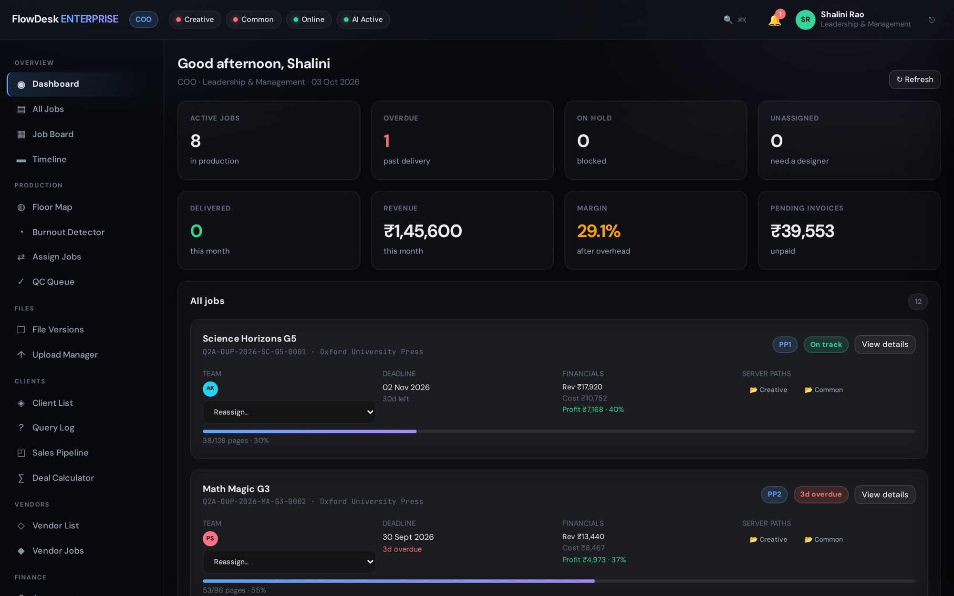
FLOWDESK ENTERPRISE · v4
Run the whole production floor from one screen.
Jobs, people, quality, clients and money — one system built for publishing studios.
Designed & built by Indrajit Mukherjee
Notes:
Open with the promise: one screen for the entire production floor. FlowDesk replaces the mix of email, Excel and chat that publishing studios run on today.

Slide 2




THE PROBLEM
Publishing production runs on scattered tools
Jobs live in spreadsheets and email threads
Overload is invisible until a deadline slips
No single place shows where every title stands today.
Managers find out a designer is buried when the client calls.
QC depends on memory
Clients chase updates by phone
A missed check — missing text, wrong image — can reach the printer.
Every 'where is my file?' call costs a project manager time.
FlowDesk Enterprise
Notes:
Name the pain the audience already lives with. Ask: how do you know today which titles are late, and who is overloaded?

Slide 3



THE SOLUTION
One flow from first layout to the printer
Illustration
PP1
QC
Corrections
PP2
PP3
Printer
Art prepared
First pages
8-point gate
Client marks
Second pass
Final pass
Delivered
Every job knows its stage
Quality is enforced
Every move is recorded
Owner, deadline, pages done and profit stay on the job card.
A job cannot leave QC until its critical checks pass.
Who changed what, and when — ready for any client question.
FlowDesk Enterprise
Notes:
Walk the real stages as built in FlowDesk: Illustration, PP1, QC, Corrections, PP2, PP3, Printer. Stress that QC is a hard gate.

Slide 4
BY THE NUMBERS
Built as a complete platform, not a prototype
324
53
56
API endpoints
database tables
production tools built in
30
9
66
roles with their own access
role-specific dashboards
automated checks guard v3 behaviour
FlowDesk Enterprise
Notes:
These figures come straight from the running system: 324 endpoints mounted at boot, 53 tables, 56 tools across 11 applications, 30 roles.

Slide 5
DASHBOARD
The whole floor at a glance
Each role opens to its own view — the COO sees every job, a designer sees only theirs.
Active, overdue, on-hold and unassigned jobs in one row
Revenue, margin and unpaid invoices for the month
Every job card shows team, deadline, profit and server paths
FlowDesk Enterprise
Notes:
Show the COO view. Point out overdue jobs in red and the live margin figure.

Slide 6
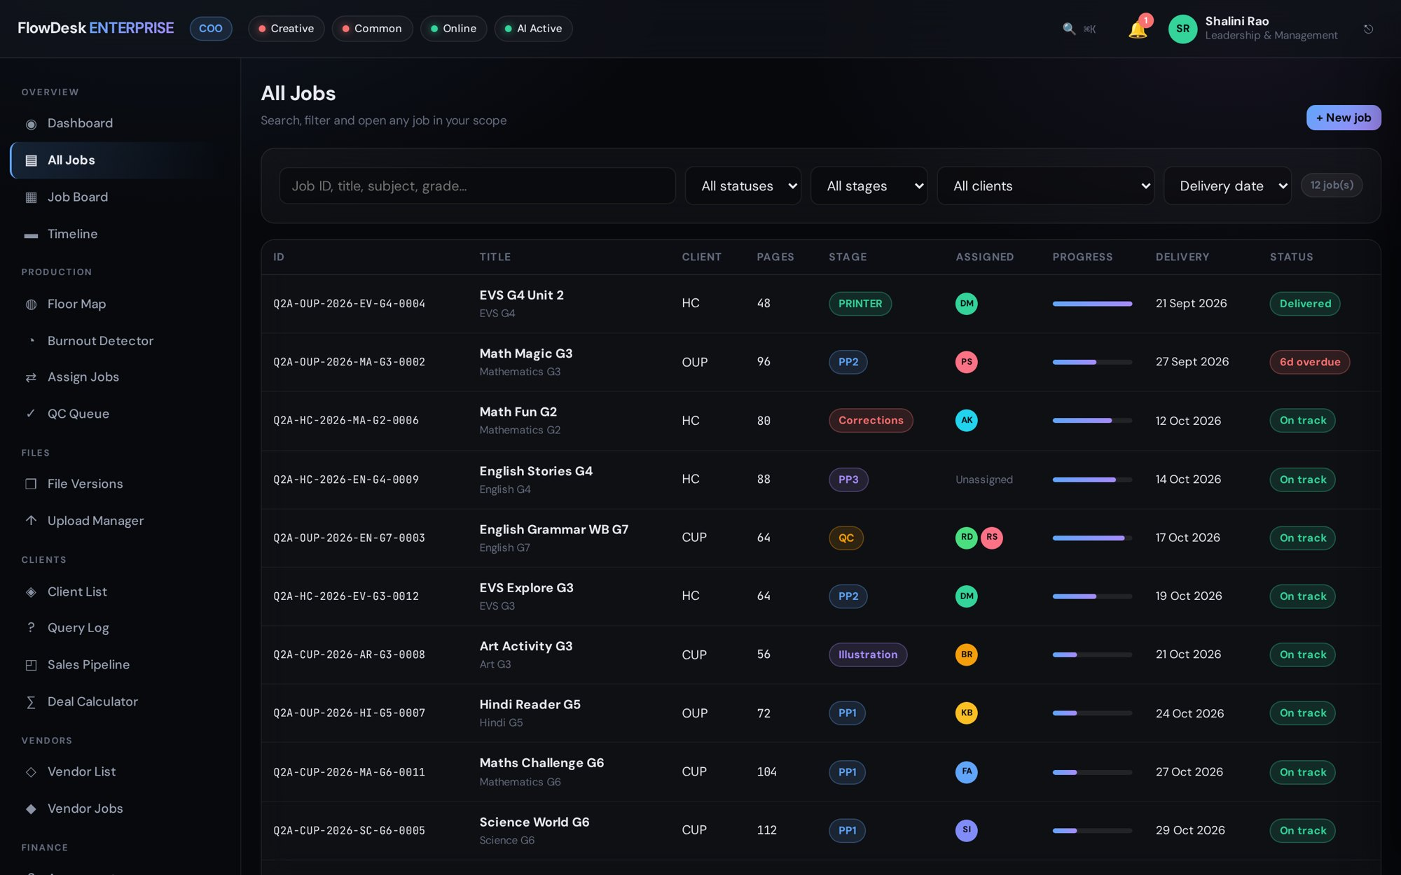
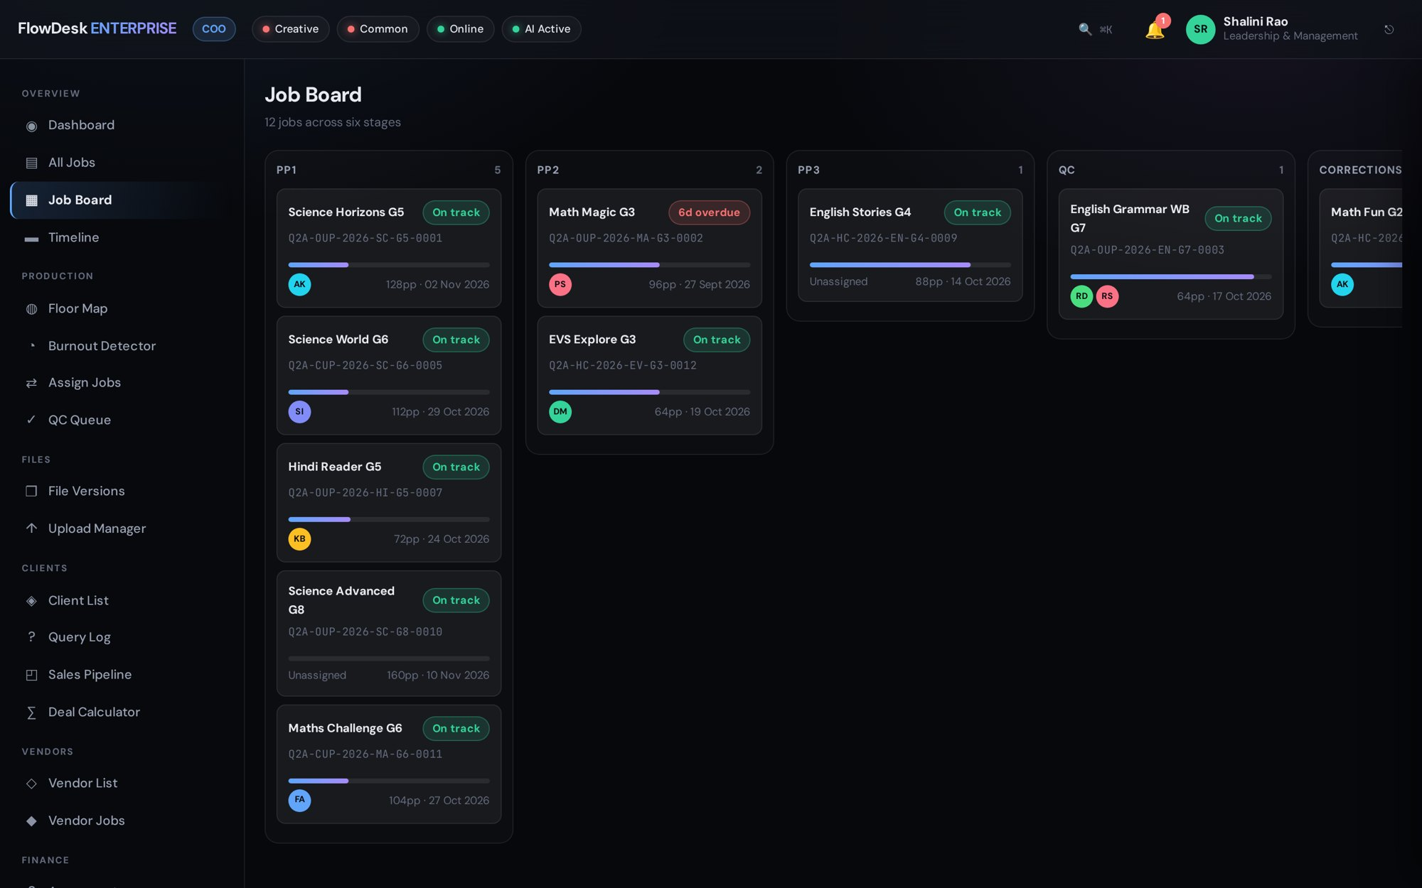
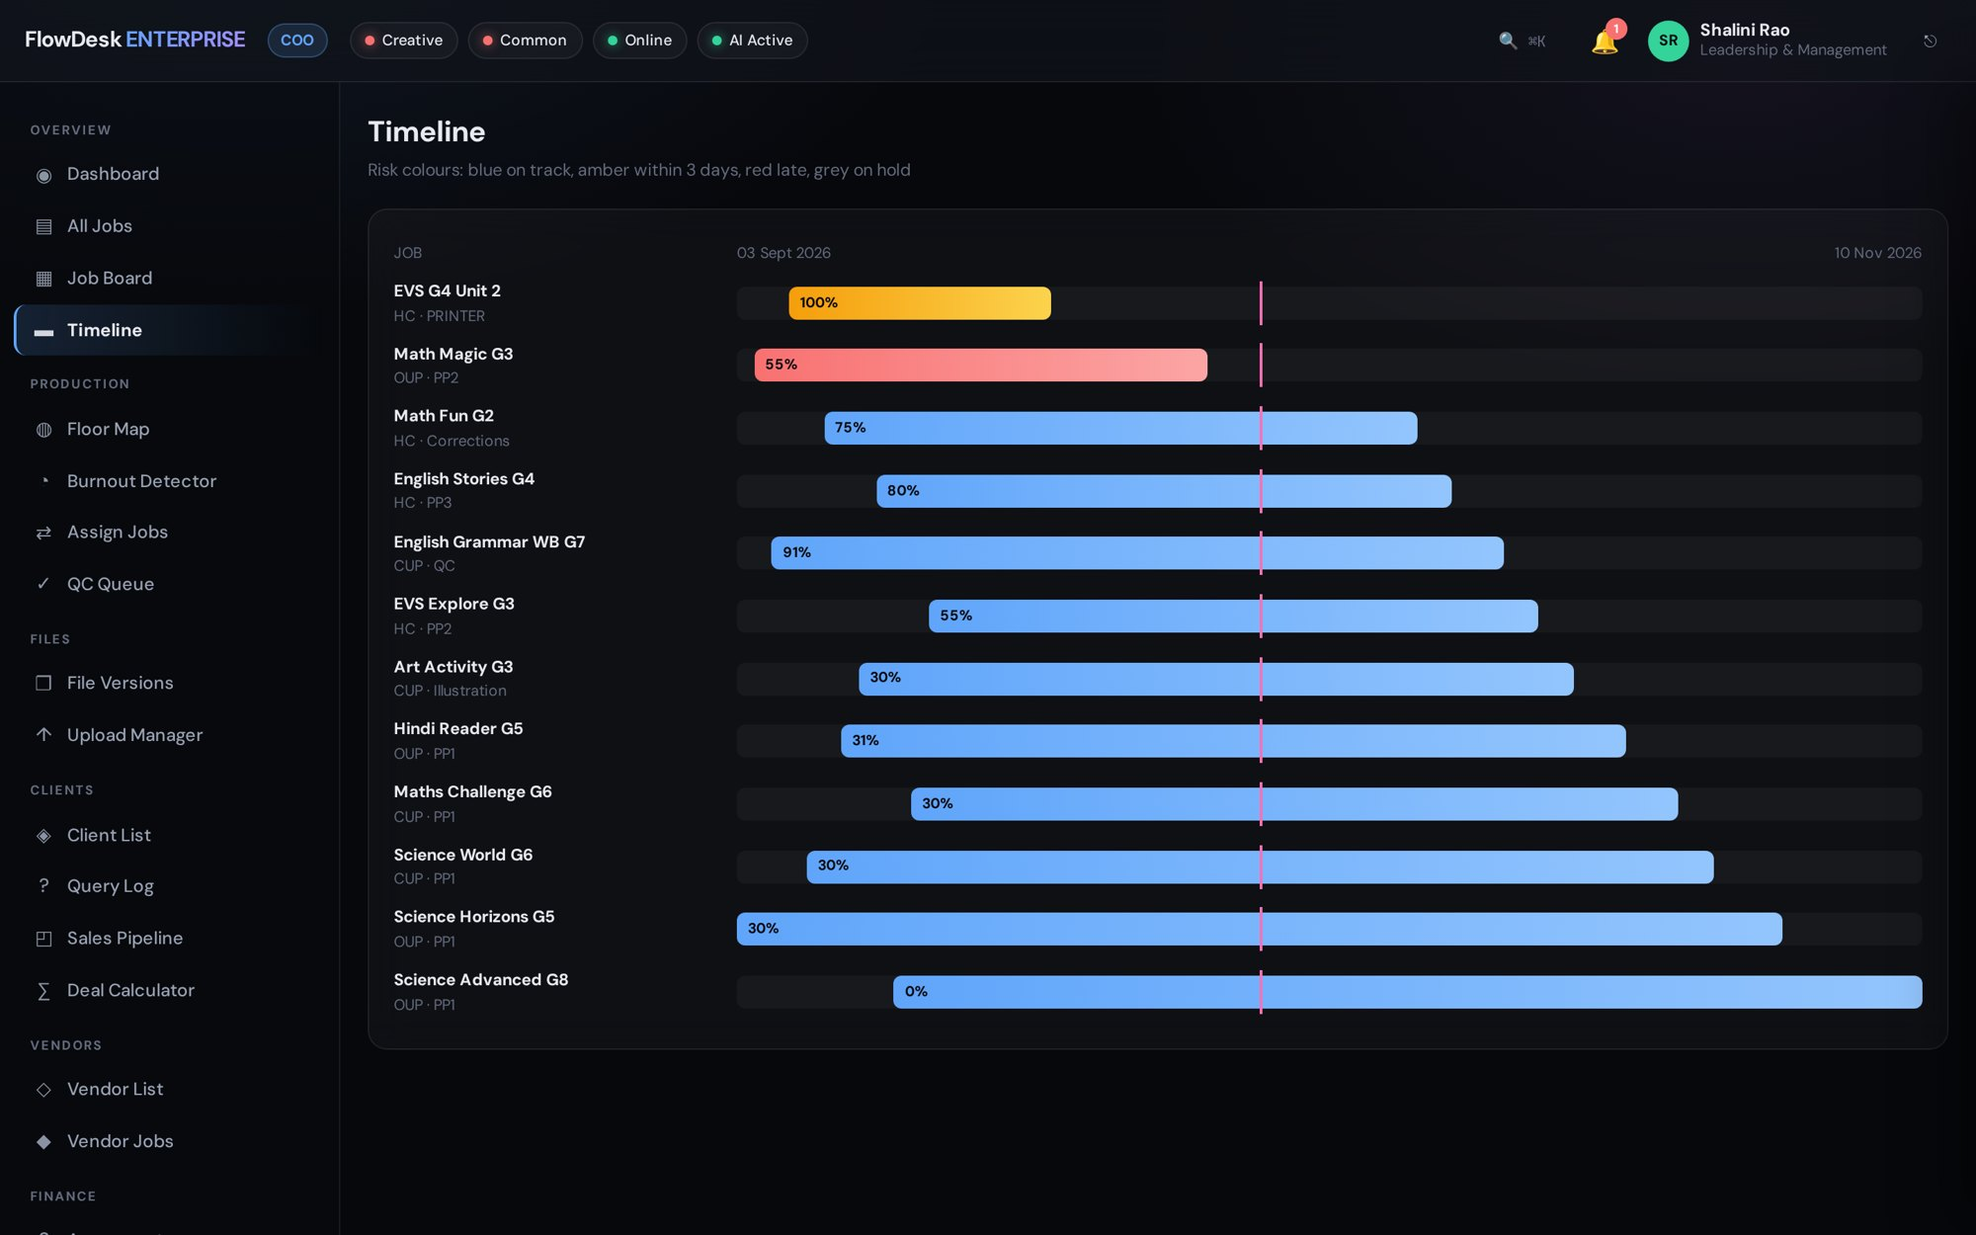
JOB MANAGEMENT
Three ways to see every job
All jobs
Job board
Timeline
Filter by client, stage, status or designer — and export the list
Drag work across stages on the board; deadlines line up on the timeline
Full lifecycle: creation, assignment, production, QC and delivery
FlowDesk Enterprise
Notes:
Same data, three views: table for managers, board for the floor, timeline for deadlines.

Slide 7
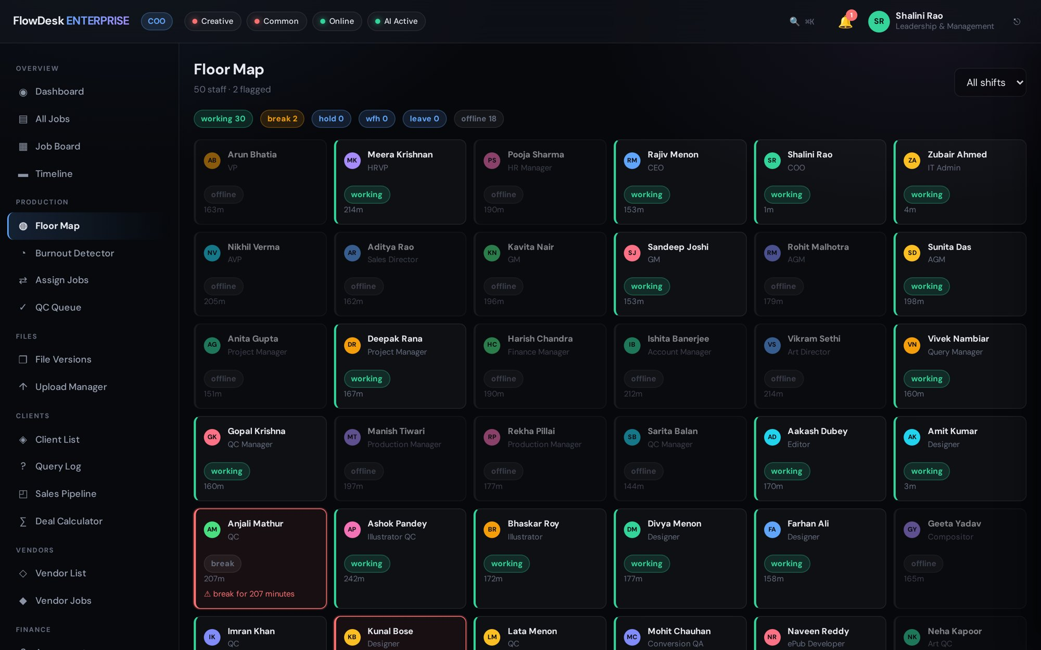
TEAM VISIBILITY
Spot overload before it hurts
The Floor Map shows every designer, their current job and their state; the Burnout Detector flags overload early.
Live status for every seat on the floor
Workload warnings before deadlines slip
Re-assign a job in two clicks
FlowDesk Enterprise
Notes:
This answers the 'who is overloaded' pain from slide 2.

Slide 8
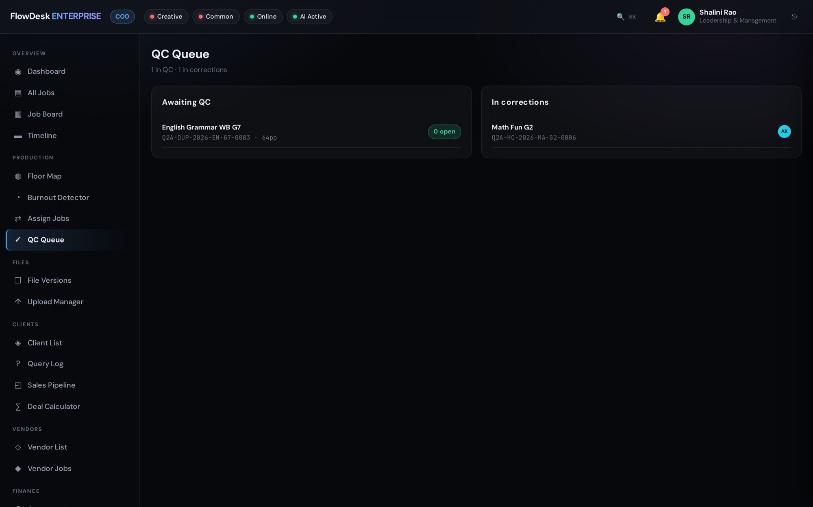
QUALITY GATE
A job cannot skip QC
Every job carries an 8-point QC checklist. Critical items — instructions followed, proofreading, missing text — block sign-off.
Severity on each check: critical, major, minor
Stage moves are refused until the quality gate is met
Errors are logged per designer for coaching
FlowDesk Enterprise
Notes:
Demo: try to advance a job with an open critical check — FlowDesk refuses with 'Quality gate not met'.

Slide 9
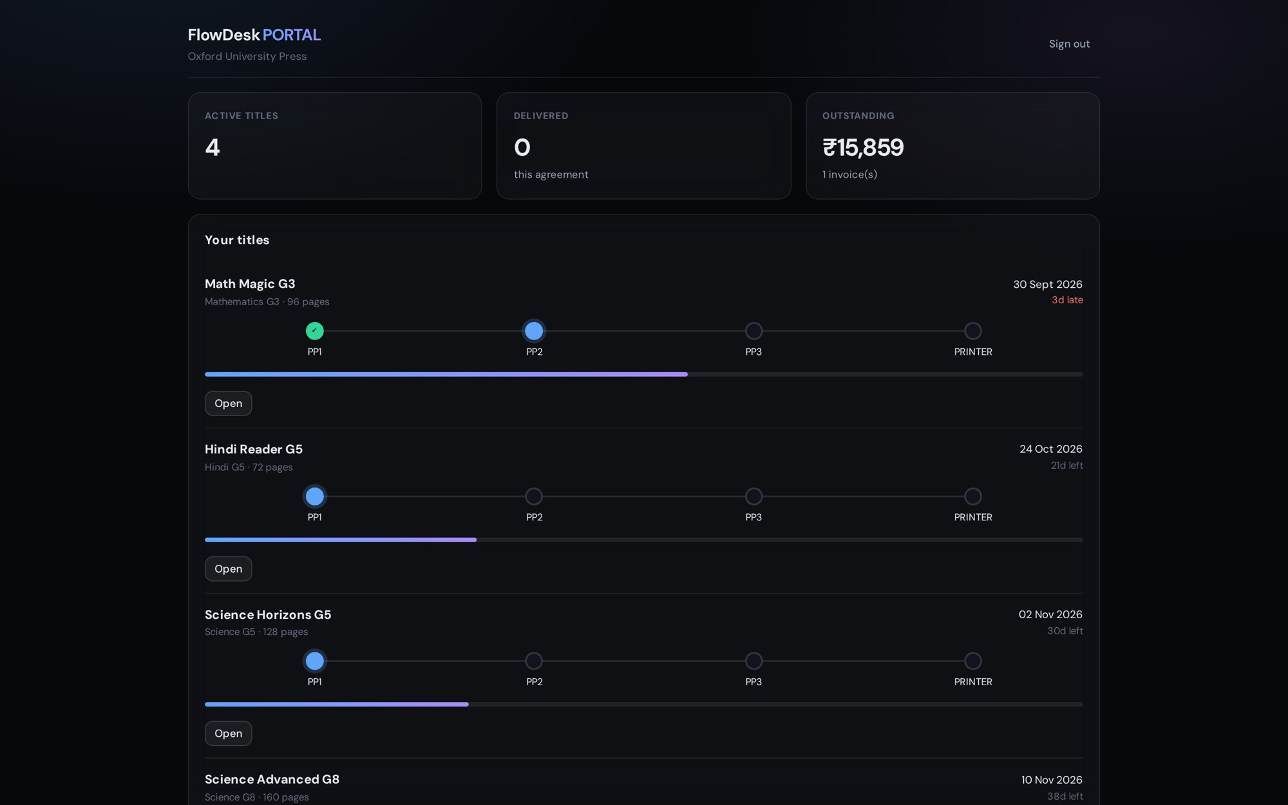
CLIENT PORTAL
Clients track their own titles
Publishers log in to see live progress, upload files, approve pages and ask questions — without calling the studio.
Live stage tracker for every title
Approve or request revisions online
Clients never see internal costs, margins or staff data
FlowDesk Enterprise
Notes:
Portal isolation is covered by the automated conformance tests.

Slide 10
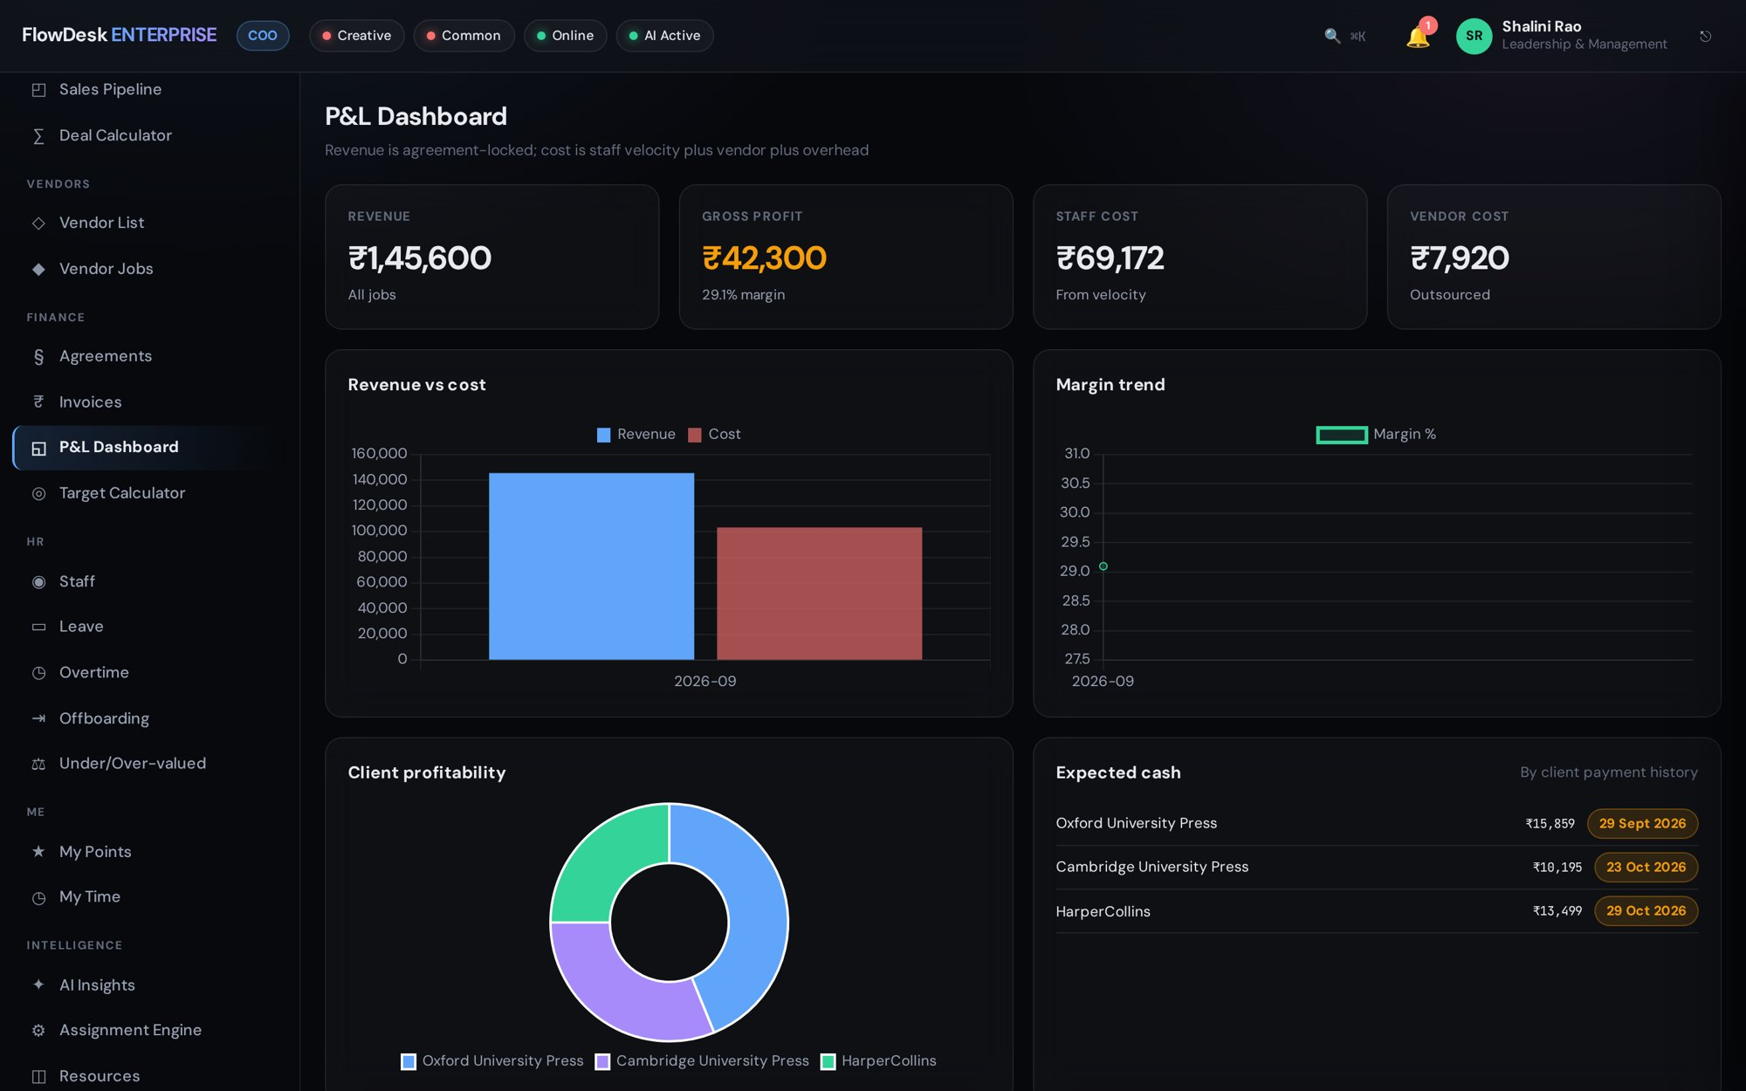
FINANCE
Profit on every job, not just every month
Revenue, cost and margin per job roll up into the P&L, invoices and client profitability.
P&L dashboard with revenue vs cost and margin trend
Invoices with status and multi-currency clients
Salary data masked on the server for anyone without permission
FlowDesk Enterprise
Notes:
Mention that salary figures never reach a browser that is not allowed to see them.

Slide 11
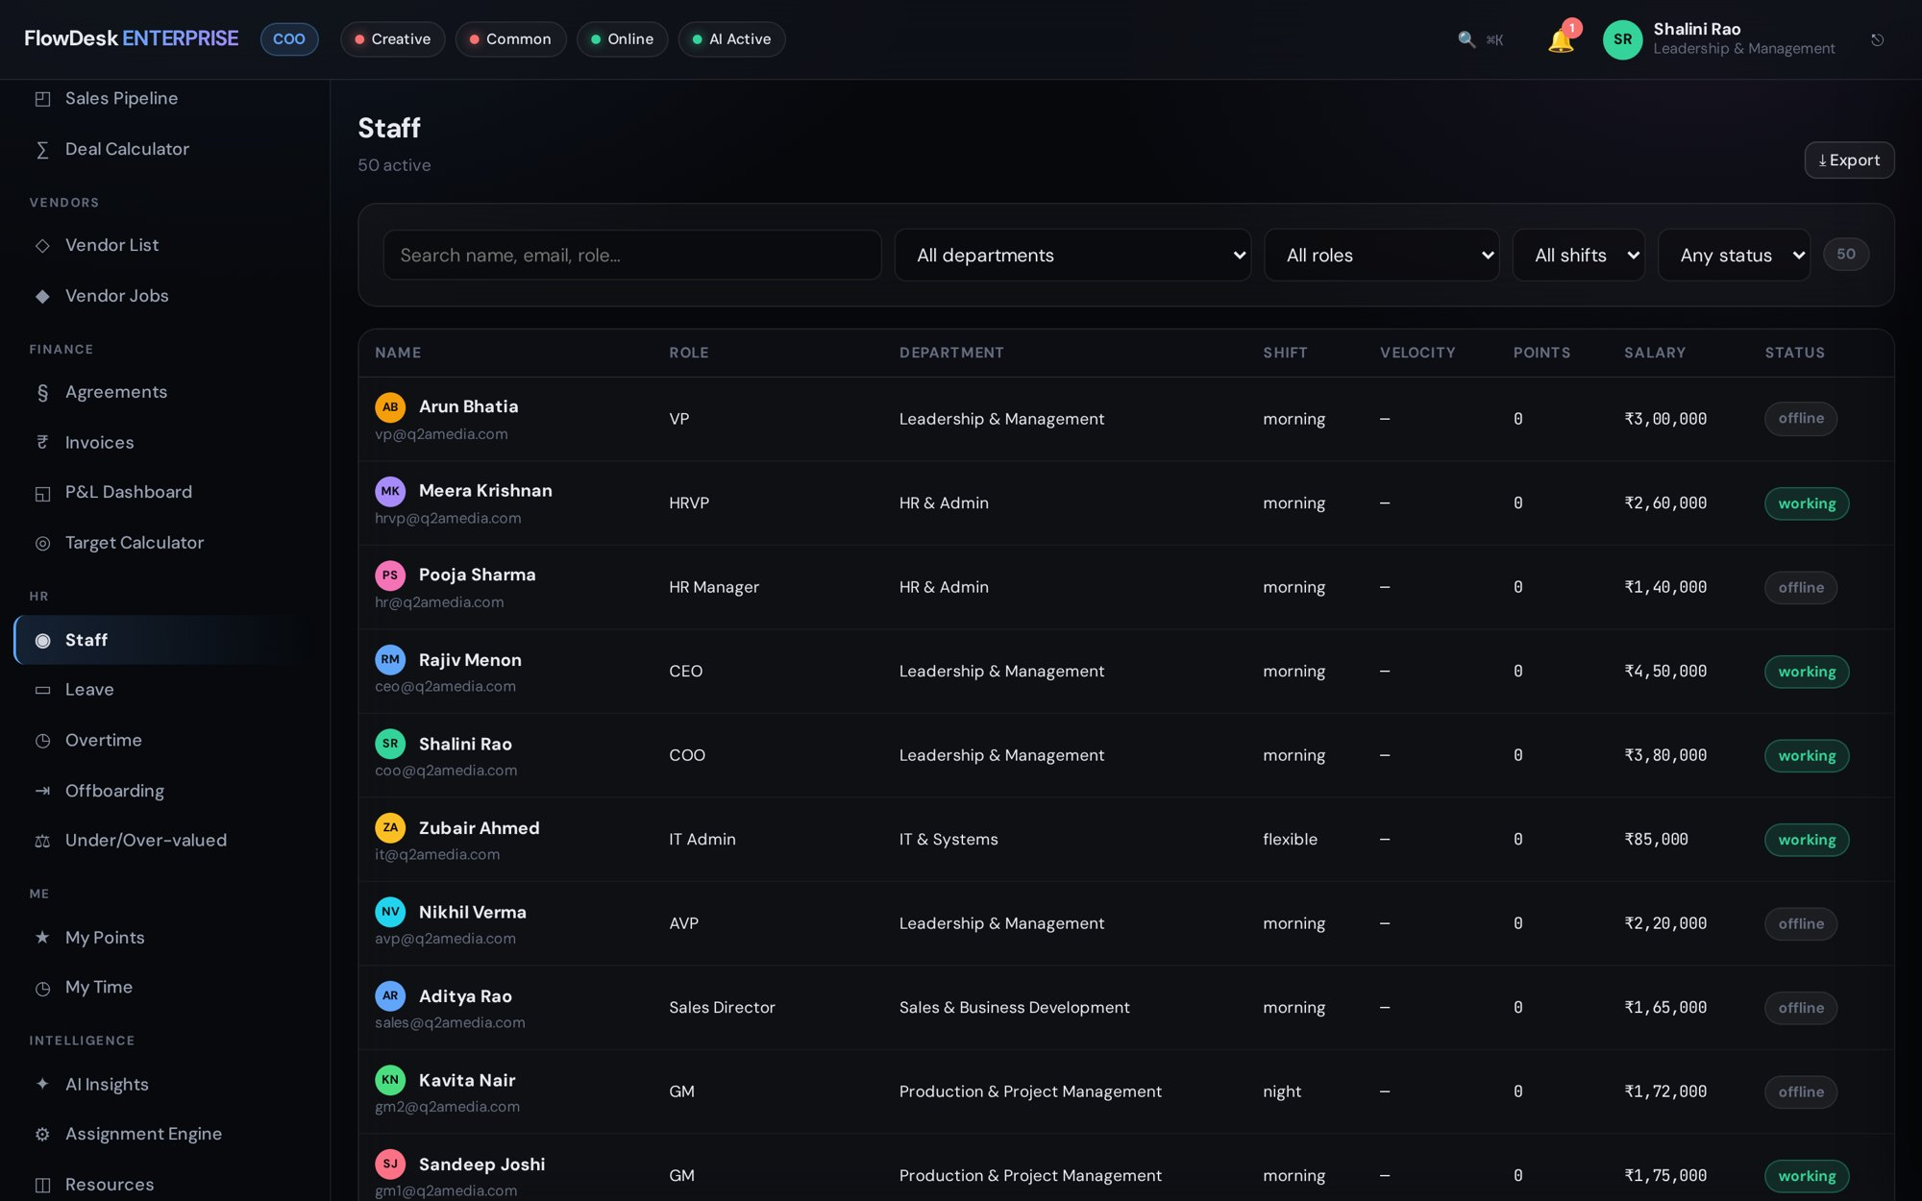
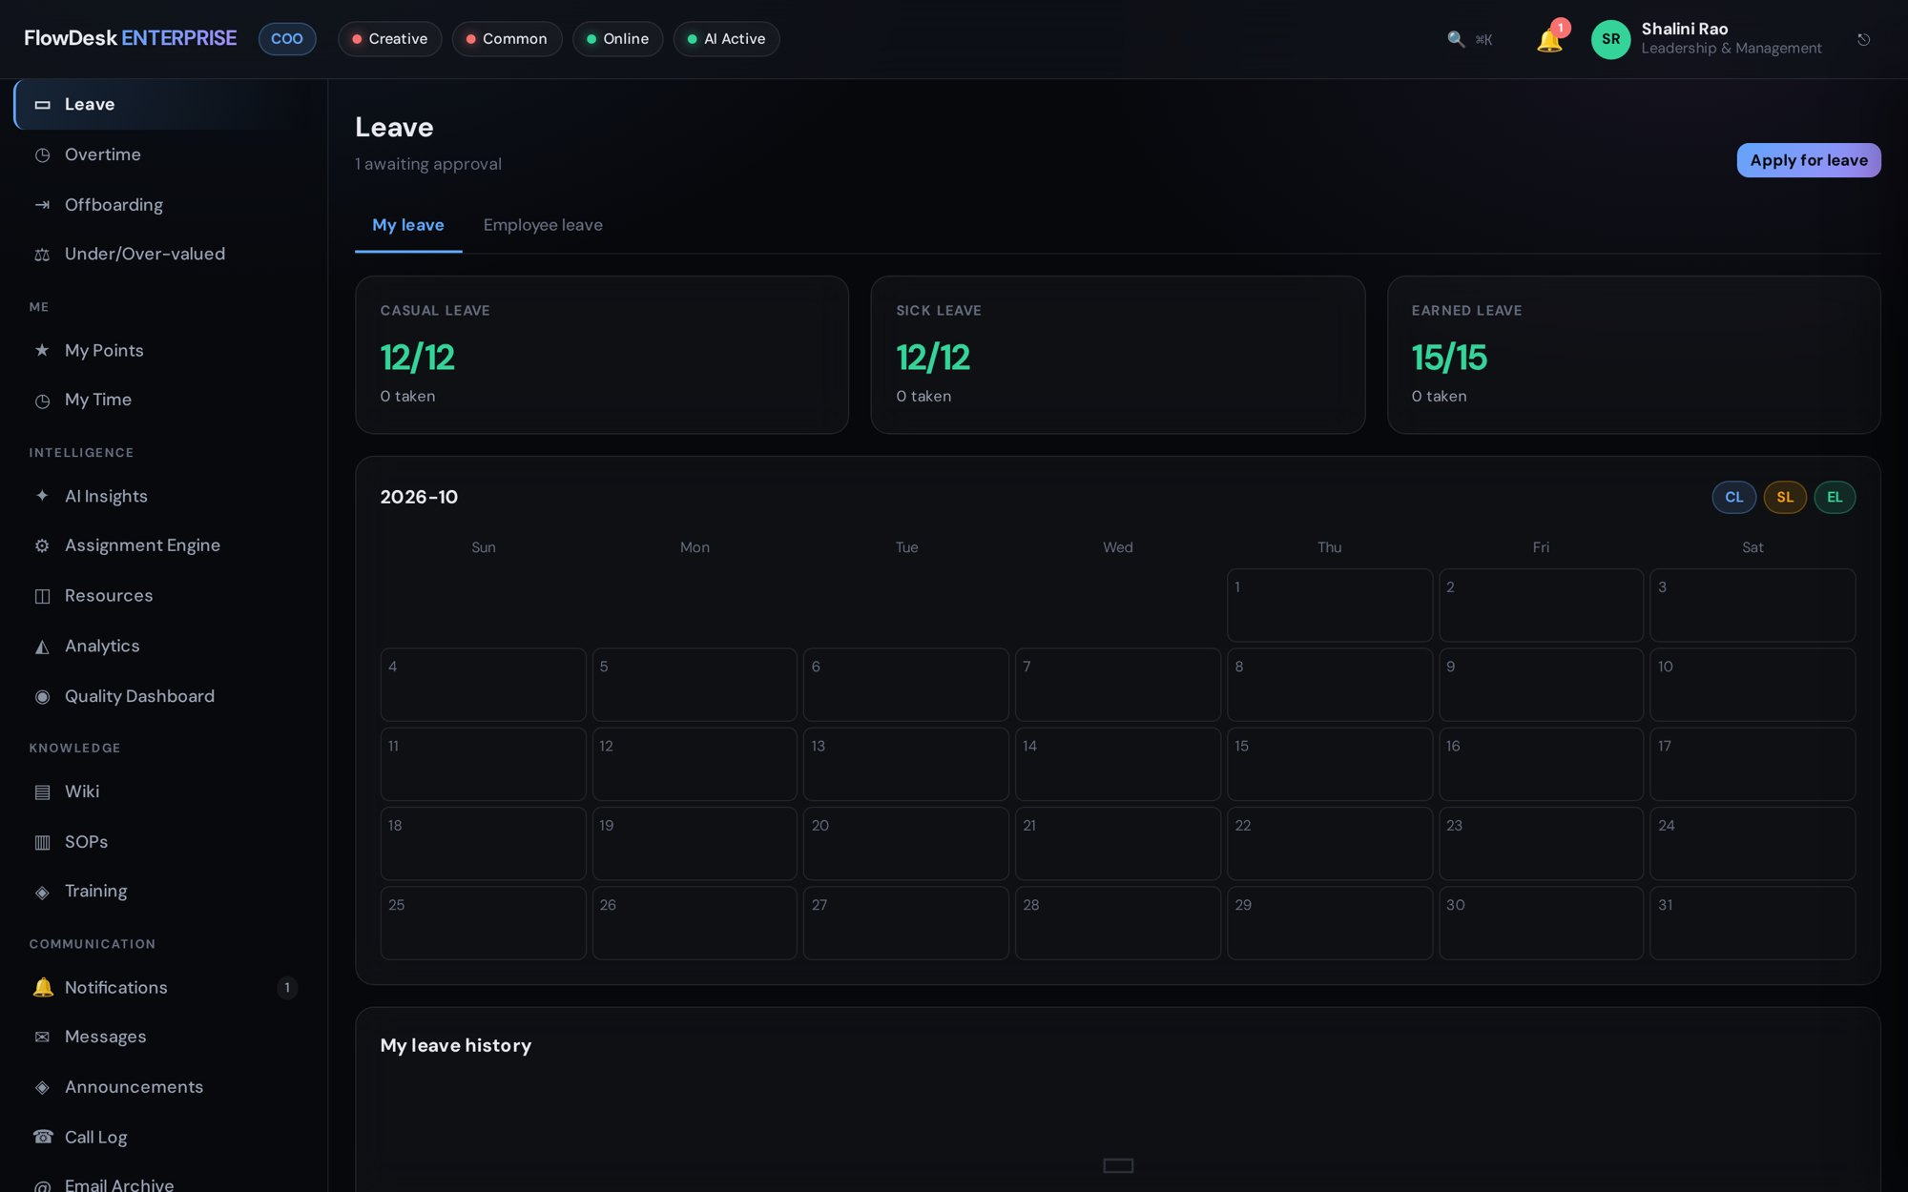
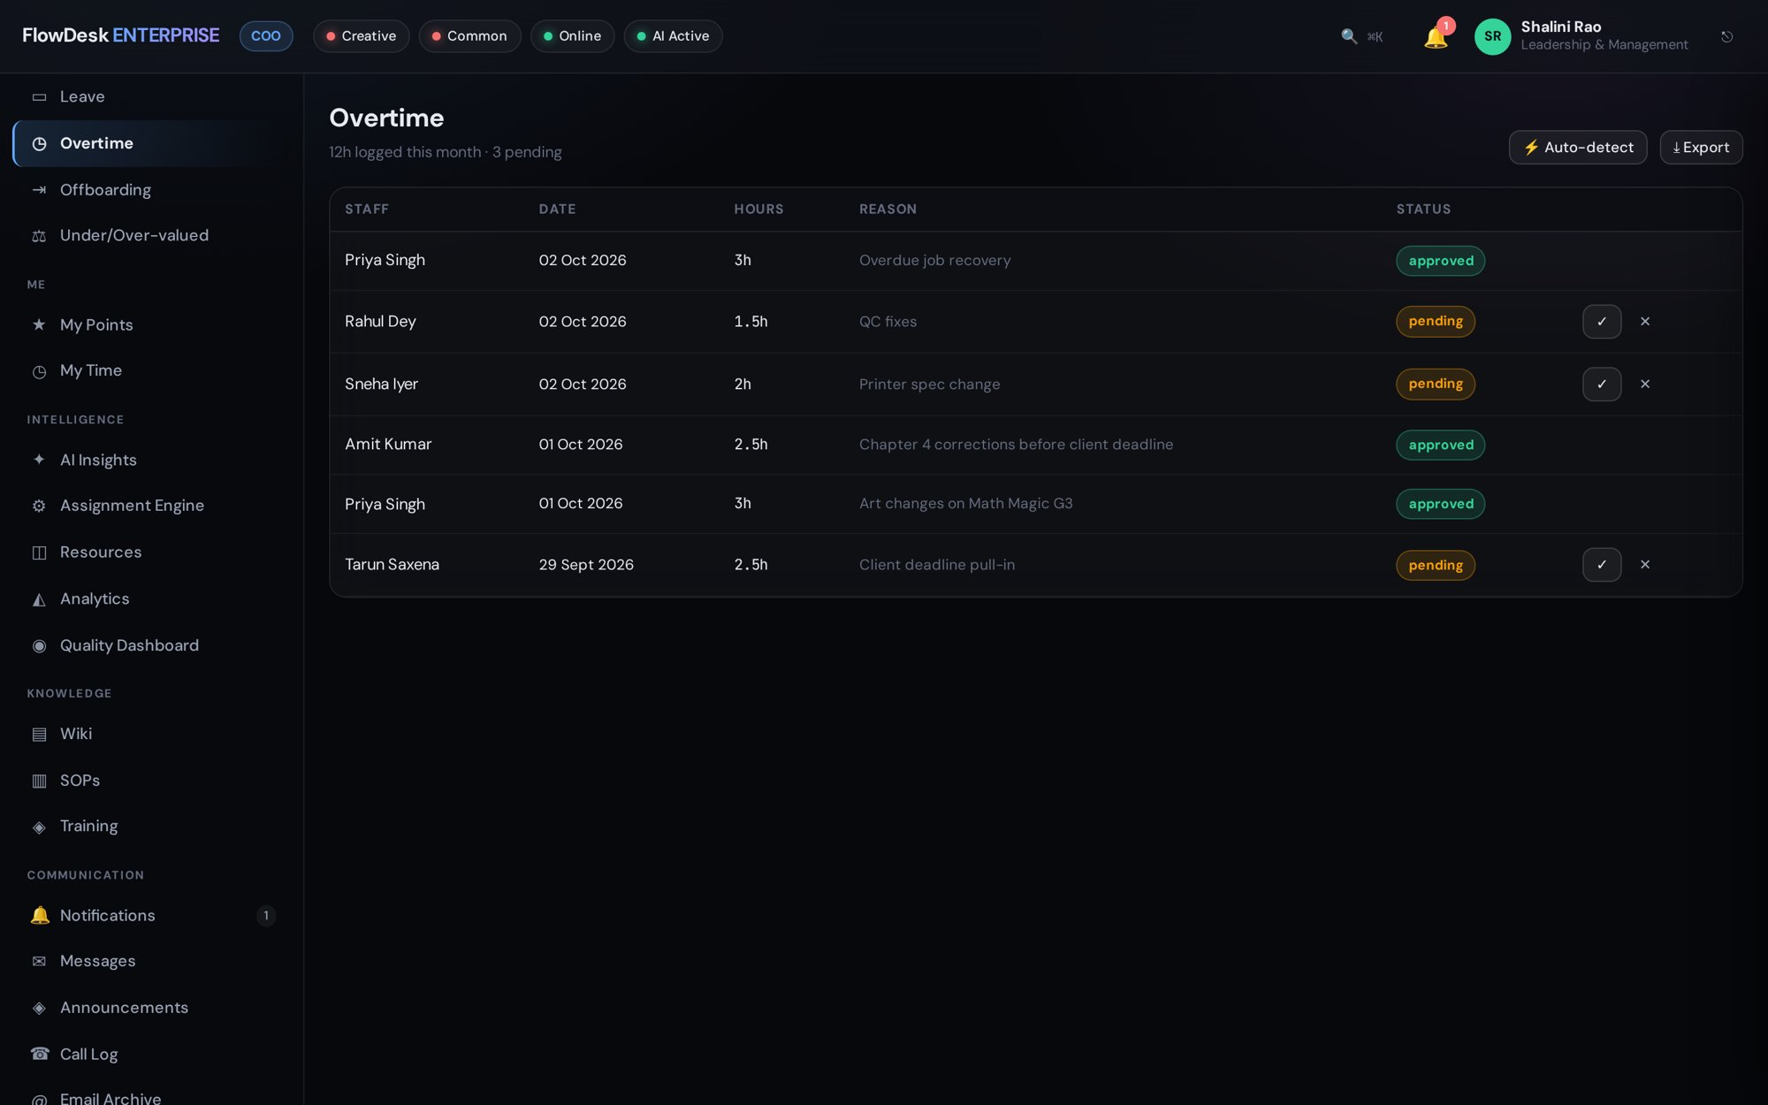
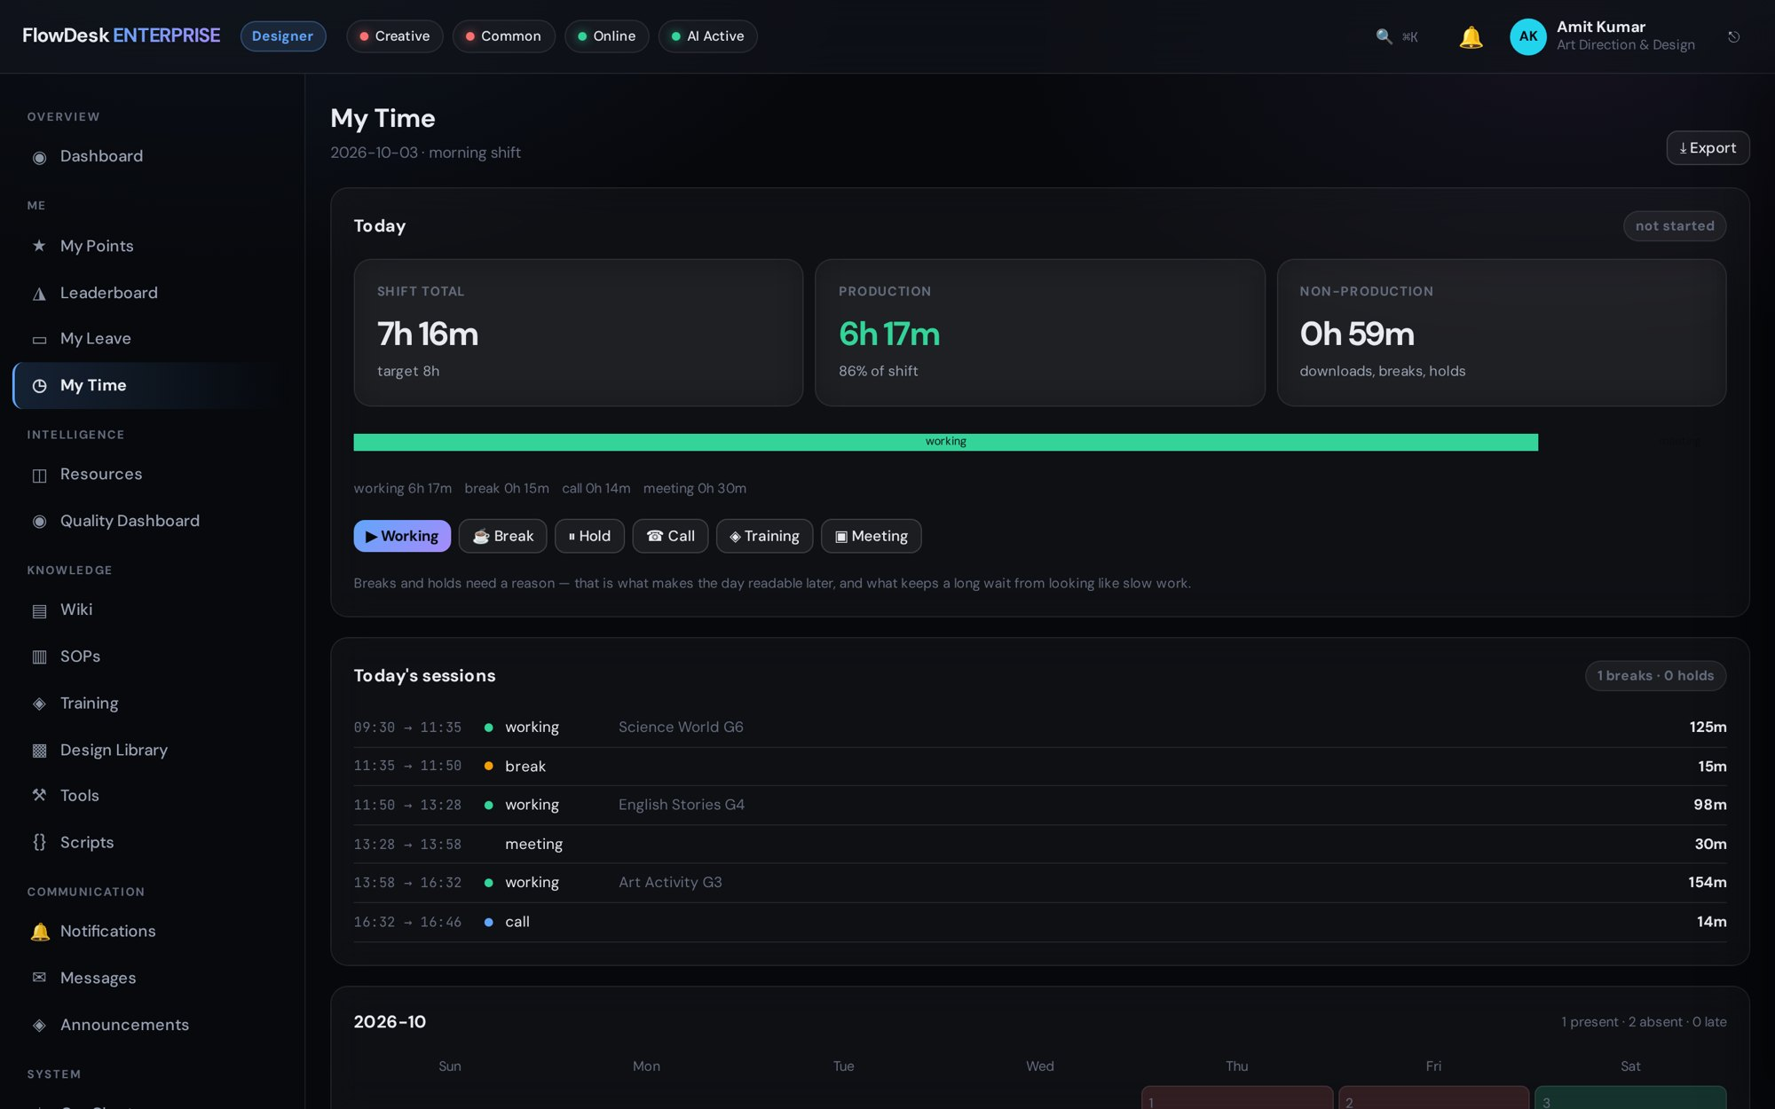
HR & TIME
People, time and attendance in the same place
Staff
Leave
Profiles, roles, reporting lines and documents.
Requests, approvals, balances and holidays.
Overtime
Time
OT requests, approvals and comp-off.
Shift time split into production and non-production.
FlowDesk Enterprise
Notes:
Production and HR share one source of truth: time logged on jobs feeds billing and attendance.

Slide 12
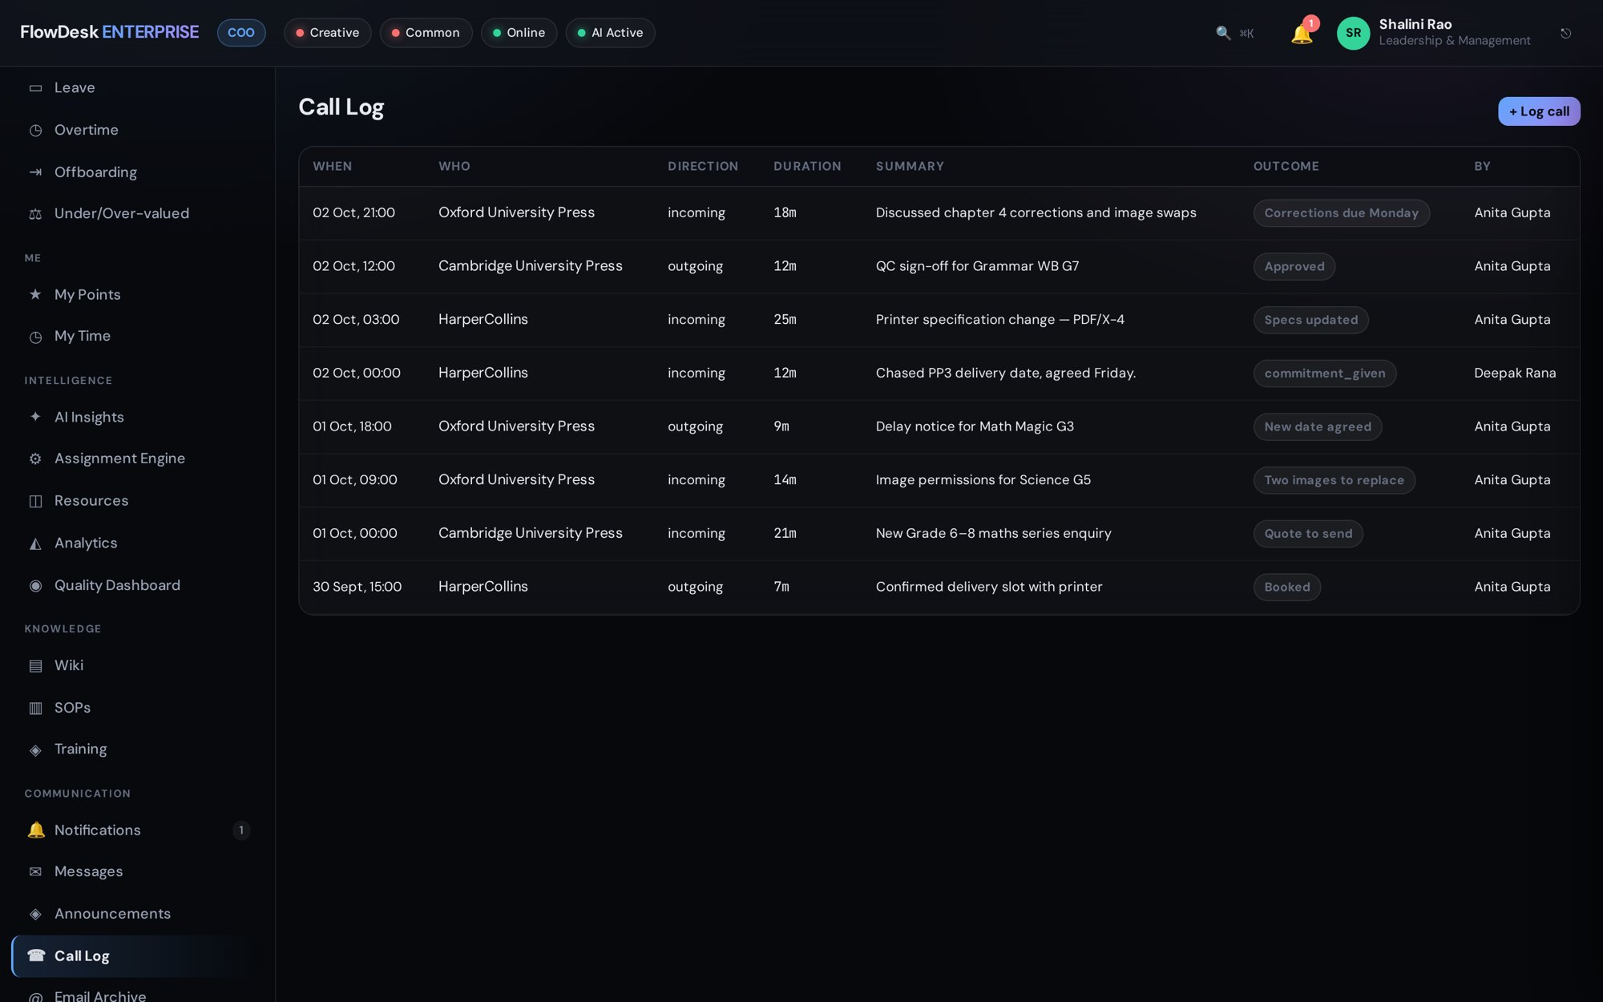
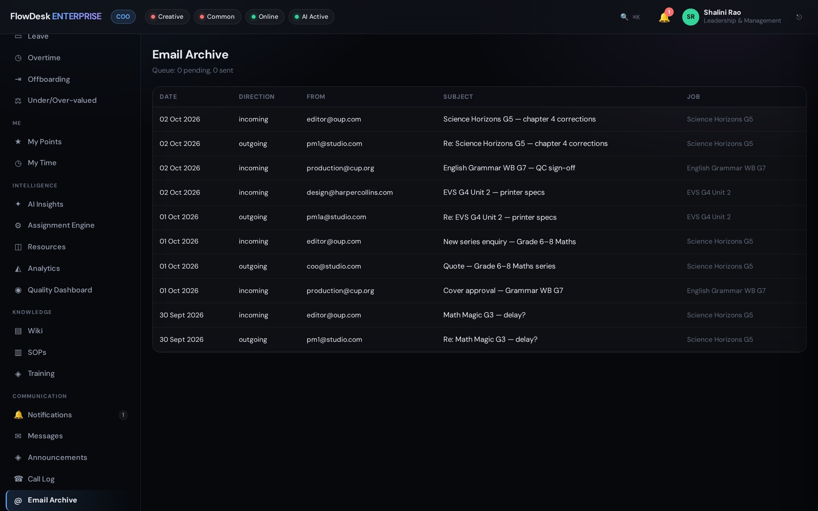
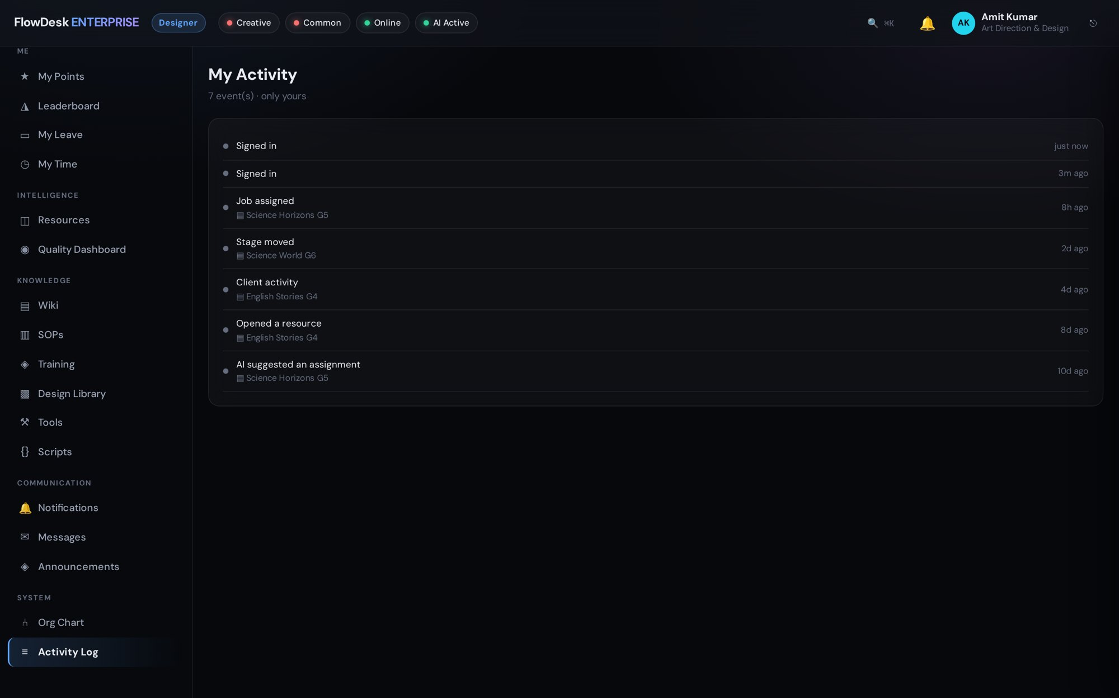
COMMUNICATION
Every client conversation, on the record
Call log
Email archive
Activity feed
Calls with outcome, duration and the job they were about.
Client mail filed against the job and searchable.
A running record of assignments, stage moves and actions.
FlowDesk Enterprise
Notes:
When a client asks 'what did we agree?', the answer is on the job.

Slide 13
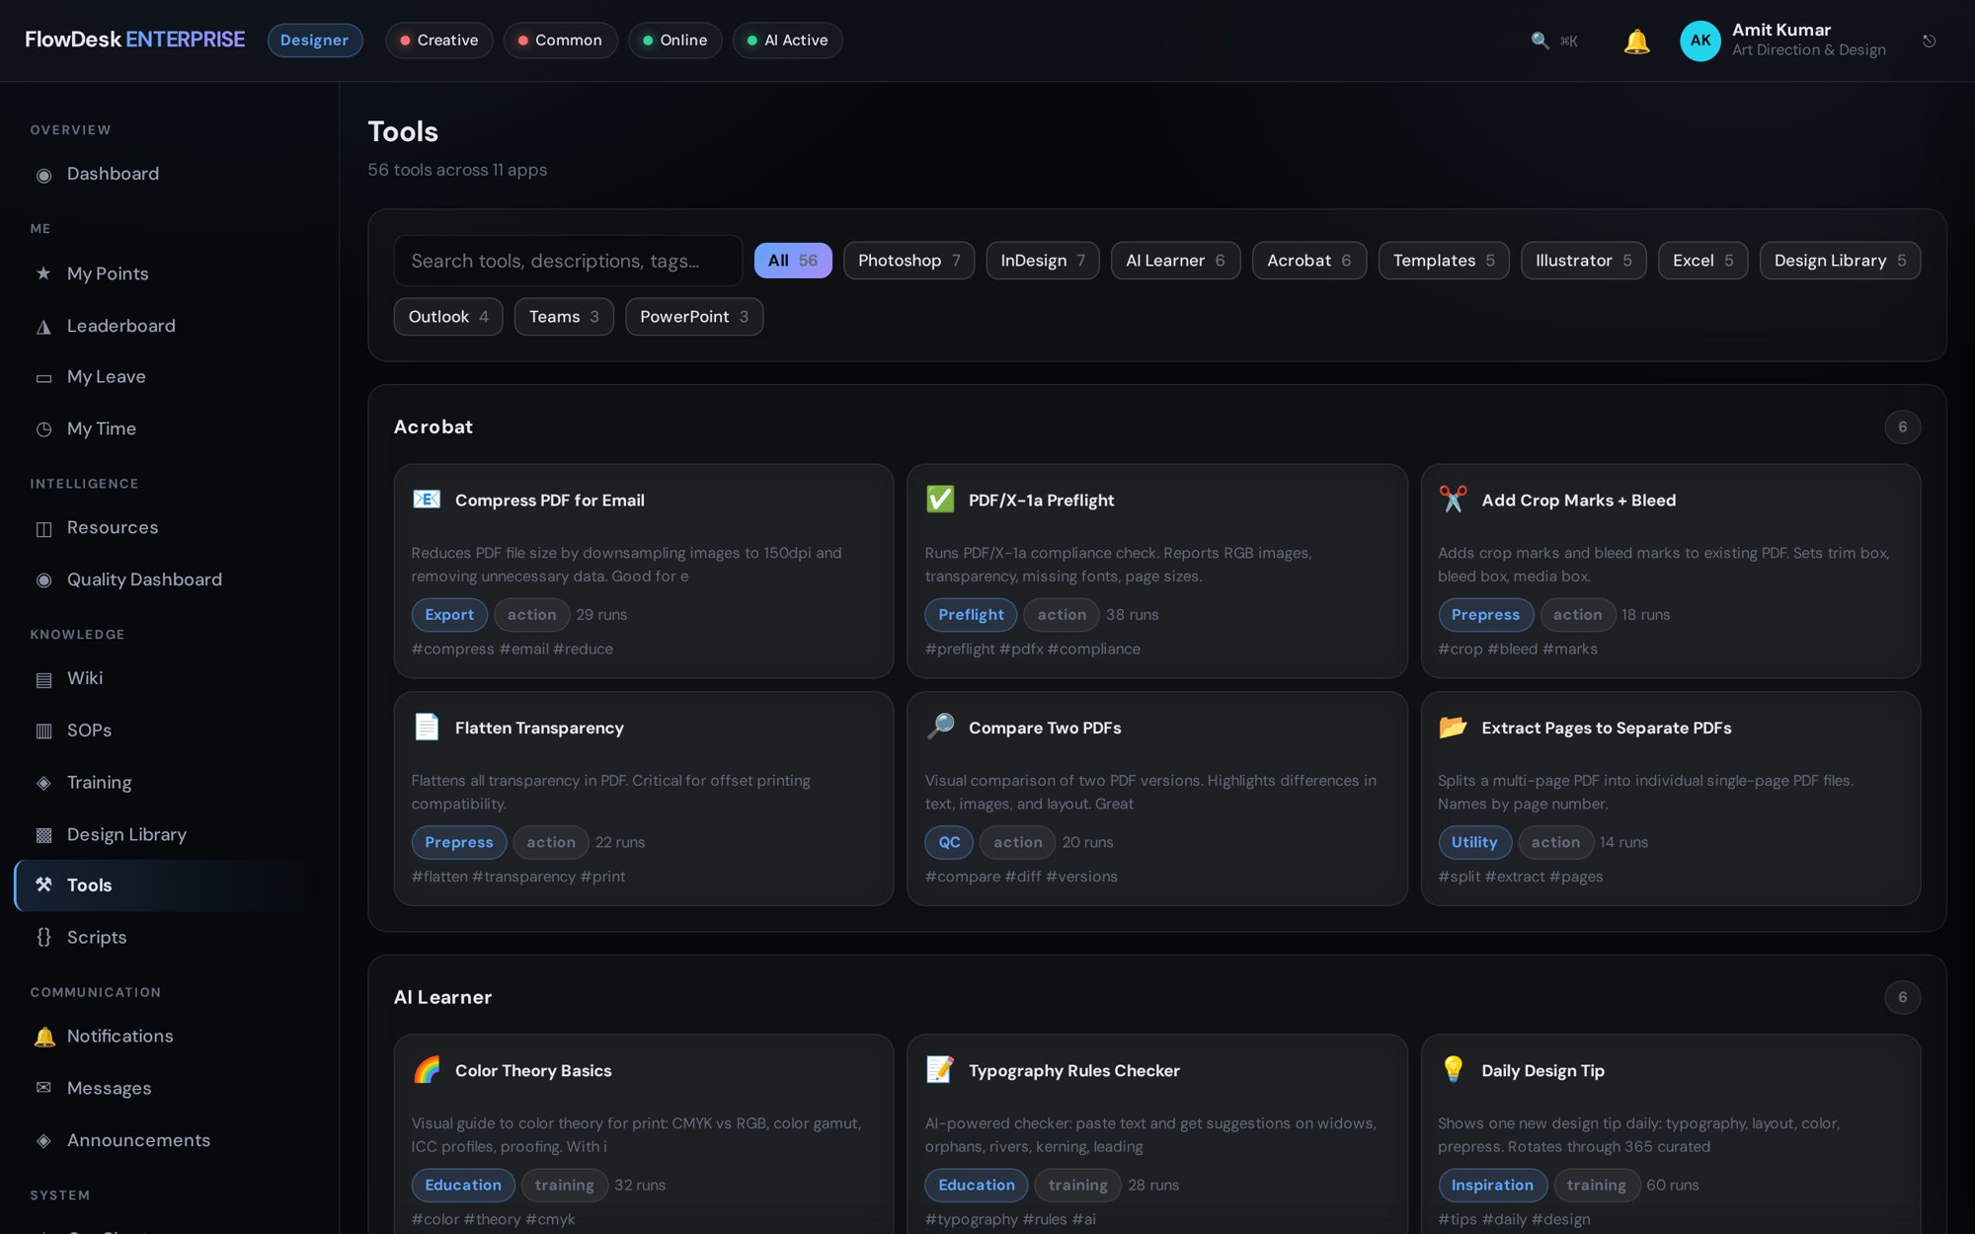
TOOLS PANEL
56 production tools, one click away
Scripts and helpers for the applications the floor already uses, organised and searchable.
Photoshop, InDesign, Illustrator, Acrobat, Excel, Outlook, PowerPoint, Teams
Templates and a shared design library
Scripts stored as files IT can inspect — never executed by the server
FlowDesk Enterprise
Notes:
56 tools across 11 applications, seeded verbatim from v3.

Slide 14
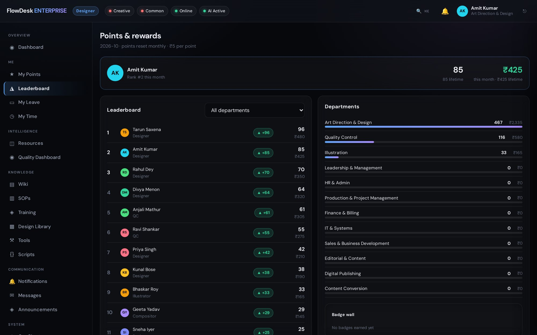
MOTIVATION
Points that reward good work
Designers earn points for on-time, first-pass-right delivery and see where they stand.
Department and studio leaderboards
Clear rules for what earns and what deducts
Badges for consistent quality
FlowDesk Enterprise
Notes:
Keep it positive: points reward quality and punctuality, which is what clients pay for.

Slide 15
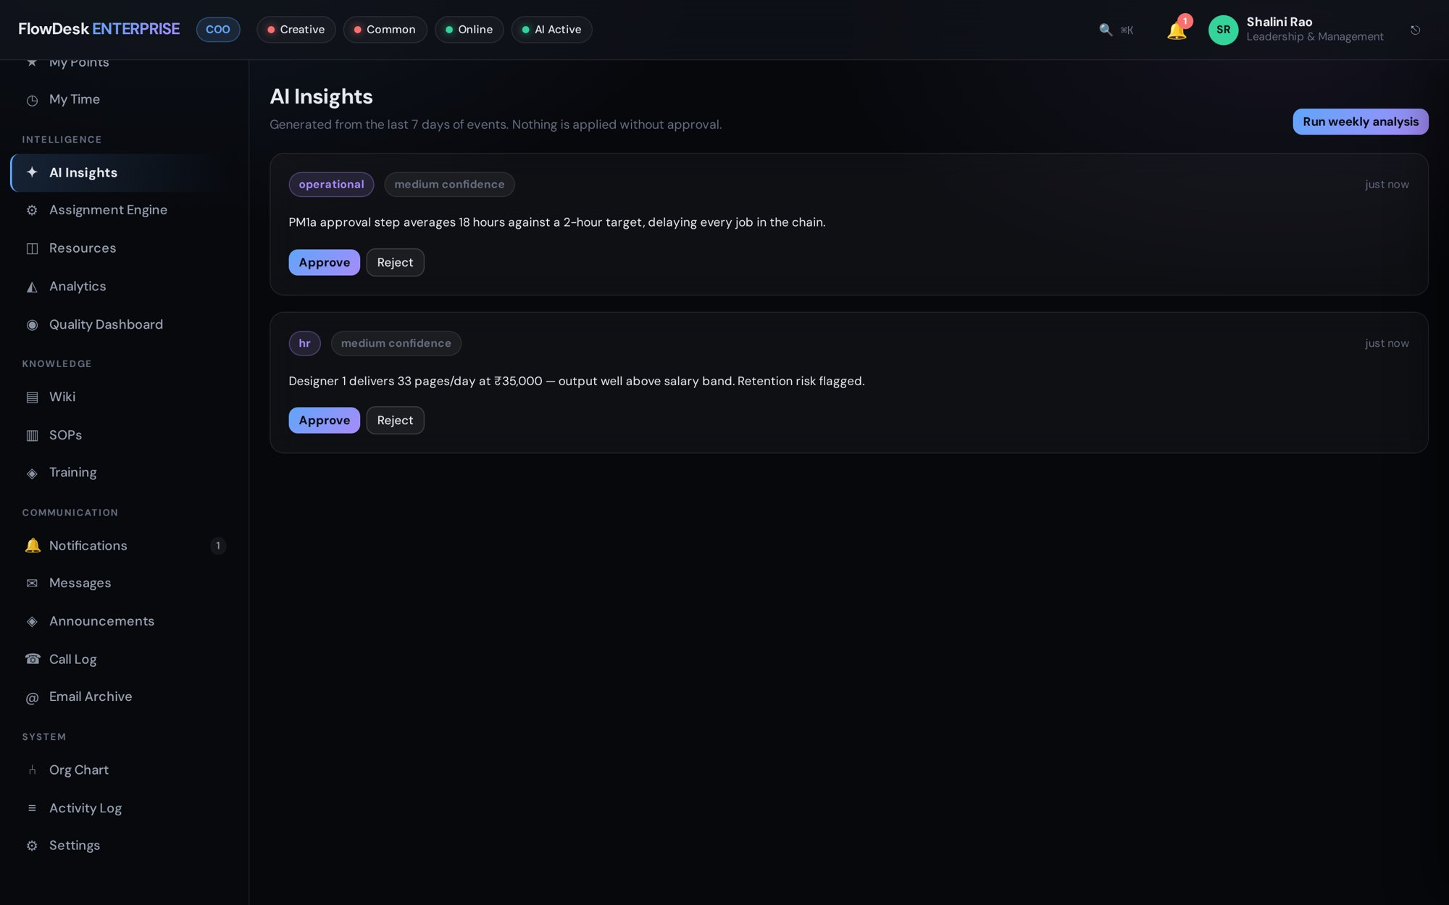
AI LAYER
AI that never stops the work
Insights and assistance with an automatic fallback across providers.
Claude → Gemini → Groq → GitHub, reorderable in settings
Providers without a key are skipped; timeouts move down the chain
If AI is unavailable the screen still works — no error state
FlowDesk Enterprise
Notes:
Every AI call logs which provider answered and which were skipped.

Slide 16






DEPLOYMENT
Made to run inside a studio
One Node.js server
Safe by design
Offline-safe uploads
No framework, no build step. Runs on the office LAN or over VPN.
Database written atomically — temp file, fsync, rename — after every commit.
Uploads queue offline and send when the line returns.
Your data leaves the building
Role-based access
Tested against regressions
Exports to Excel, with CSV fallback, for every report.
30 roles; clients and vendors see only their own work.
66 conformance checks run before every deploy.
FlowDesk Enterprise
Notes:
For the IT audience: simple to host, safe with data, tested before every release.

Slide 17
See FlowDesk running on your own jobs.
A live demo takes 20 minutes: dashboard, a job through QC, and the client portal.
Indrajit Mukherjee
indrajitmukh@gmail.com
WhatsApp +91 97160 69568
Notes:
Close by offering a demo on their own data.

